Slide 1
OTT Customer Churn Analysis Capstone
End-to-End Business Analyst Capstone Project
Prepared By: Abhijeet Kedar
Excel • SQL • Power BI • DAX • Power Query

Slide 2
Executive Summary
Analyze customer churn
Measure business KPIs
Develop interactive Power BI dashboard
Provide strategic recommendations

Slide 3
Business Problem
High churn impacts recurring revenue.
Business needs actionable retention insights.
Identify churn drivers and upgrade opportunities.

Slide 4
Business Objectives
Reduce churn
Improve customer retention
Increase upgrade acceptance
Support data-driven decisions

Slide 5
Business Analysis Lifecycle
Business Problem
BRD
FRD
Excel
SQL
Power BI
Insights
Recommendations

Slide 6
Tools & Technologies
Microsoft Excel
SQL Server
Power BI
DAX
Power Query
Microsoft Word

Slide 7
Key Project KPIs
Churn Rate: 49.03%
Upgrade Acceptance Rate: 51.93%
Total Revenue: 101M
Premium Revenue: 35M
Standard Revenue: 34M
Basic Revenue: 32M
Highest Revenue City: Hyderabad
Average Rating: 3.77
163 churned customers had support interactions

Slide 8
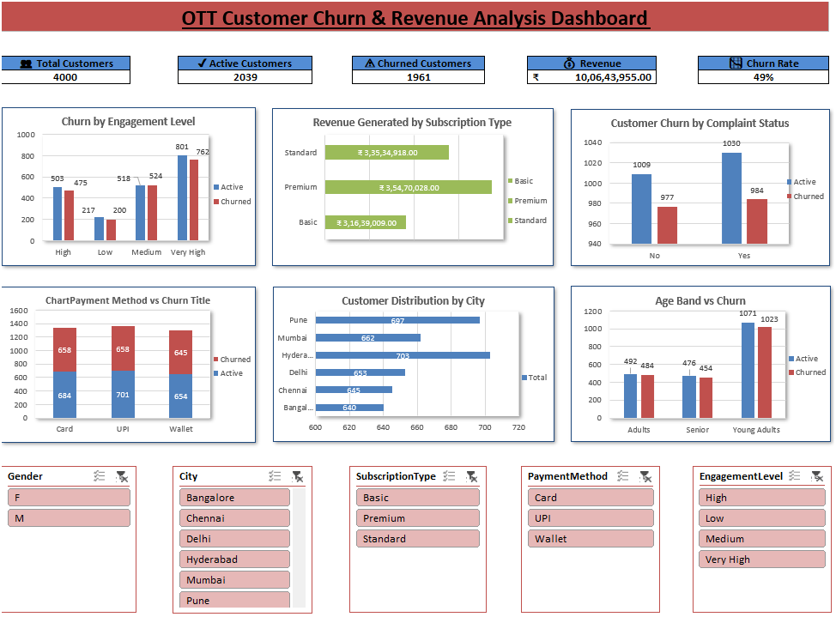
Excel Analysis & Dashboard

Slide 9
Excel Analysis & Dashboard
Purpose
The Excel dashboard was created to perform exploratory data analysis using Pivot Tables, Pivot Charts, KPIs, and Slicers. It provided an initial understanding of customer behaviour, subscription trends, revenue distribution, and churn patterns before building the SQL analysis and Power BI dashboard.
Key Observations
Customer churn patterns were identified across different subscription plans.
Revenue distribution varied by subscription type and customer location.
Customer engagement and support metrics highlighted potential churn risks.
The dashboard validated business metrics used in the Power BI solution.
Short Insight:
Churn Rate is 49 %.
Customers with Very High engagement have the highest churn.
Premium Subscription contributes the highest share of total revenue.
Customers with Complaint Flag = Yes show higher churn.
Hyderabad city contributes the largest customer base.
Young Adults age group has the highest churn.

Slide 10
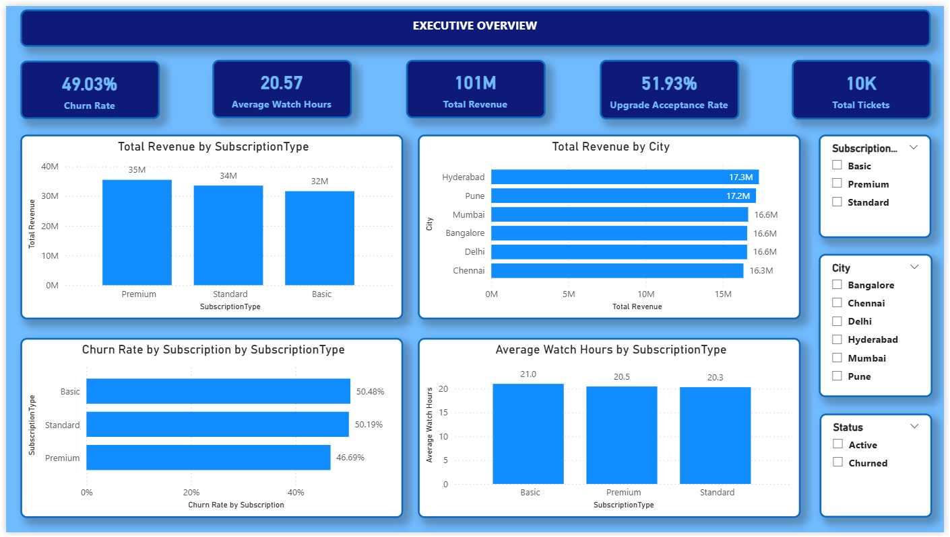
Executive Overview Dashboard
Short Insight:
The platform generated 101M in total revenue.
The 49.03% churn rate indicates a significant retention challenge.
More than half of the customers offered an upgrade accepted it (51.93%).

Slide 11
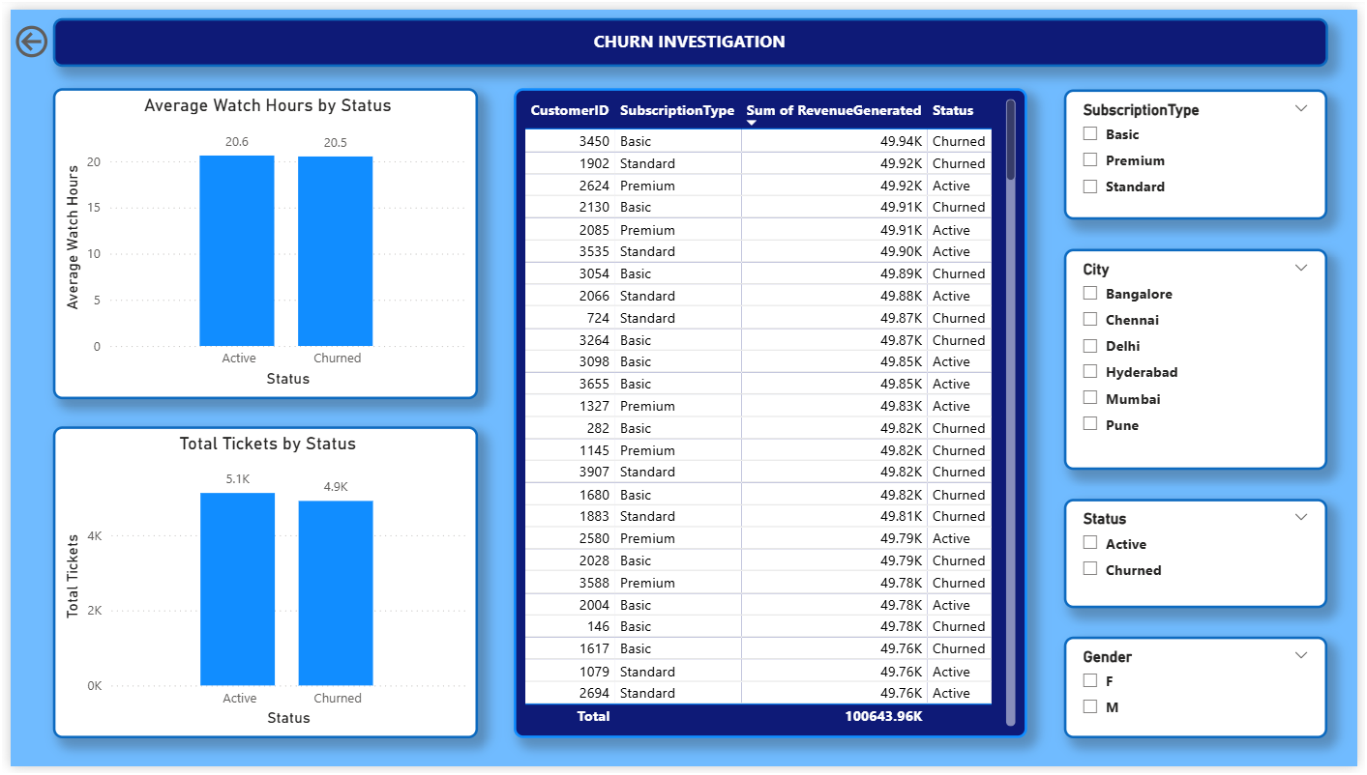
Churn Investigation Dashboard
Short Insight:
Customers with lower engagement are more likely to churn.
Support interactions are higher among churned customers.
Customer-level drill-through helps identify specific churn patterns.

Slide 12
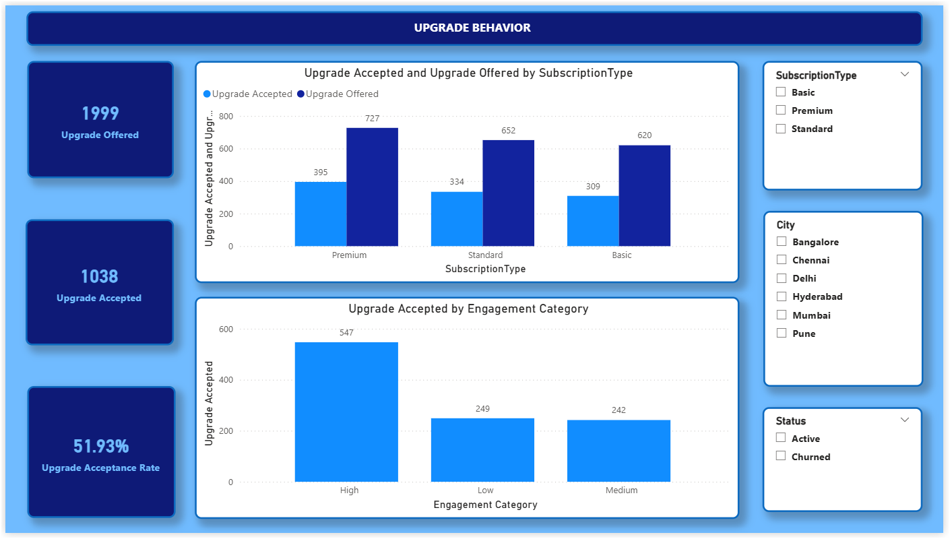
Upgrade Behavior Dashboard
Short Insight:
Highly engaged customers show the highest upgrade acceptance.
Upgrade campaigns are performing well with a 51.93% acceptance rate.
Basic and Standard users represent strong upgrade opportunities.

Slide 13
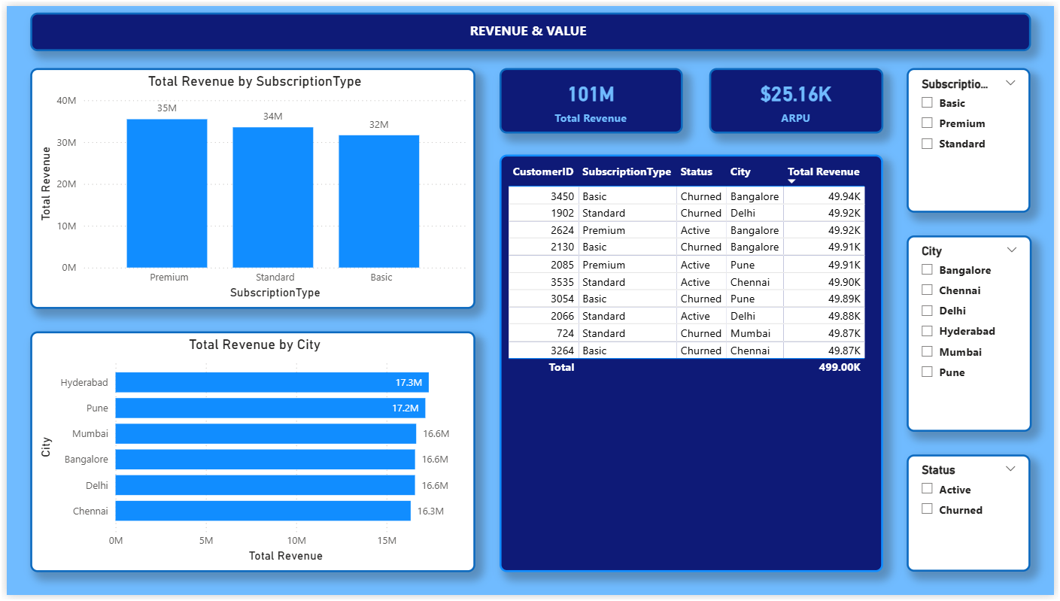
Revenue & Value Dashboard
Short Insight:
Premium Subscription generated the highest revenue (35M).
Hyderabad is the highest revenue-generating city.
Top customers contribute a significant share of total revenue.

Slide 14
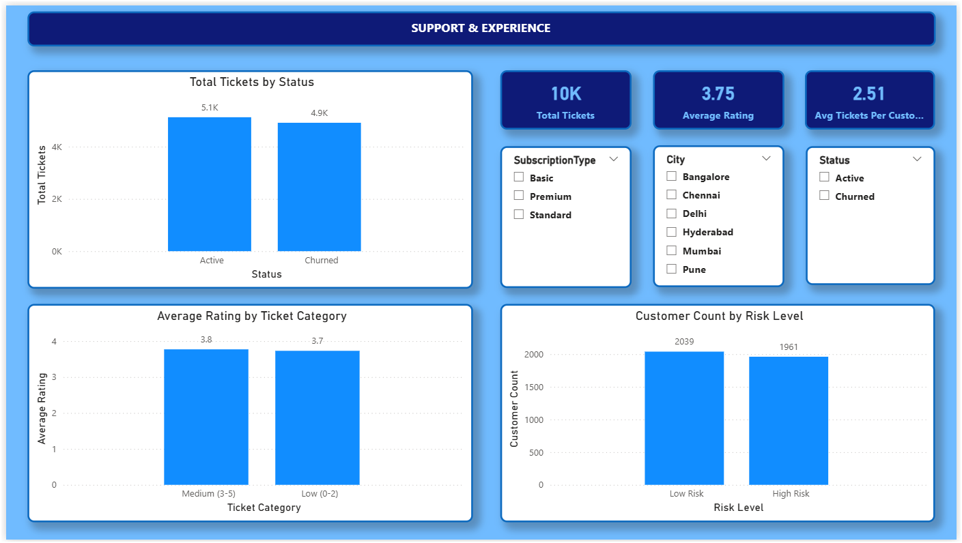
Support & Experience Dashboard
Short Insight:
163 churned customers had support interactions before leaving.
Customers have a moderate level of satisfaction (3.77/5), indicating opportunities to improve the overall user experience and customer support to increase retention.(Average Rating = Sum of all ratings/ Number of Rating).
Risk analysis helps identify customers needing proactive retention efforts.

Slide 15
Key Business Insights
High engagement alone did not guarantee retention.
Premium subscription generated the highest revenue.
Hyderabad contributed the highest revenue.
163 churned customers interacted with support before leaving.
Average customer rating was 3.77 indicating moderate satisfaction.

Slide 16
Business Recommendations
Target high-risk customers with retention campaigns.
Improve onboarding and engagement.
Run personalized upgrade offers.
Monitor KPIs regularly through Power BI.

Slide 17
Project Deliverables
BRD
FRD
Excel Analysis
Excel Dashboard
SQL Scripts
Power BI Dashboard
ER Diagram
Data Model
Final Report
GitHub Repository

Slide 18
Thank You
Questions & Discussion
Abhijeet Kedar
Business Analyst | Data Analyst

